Slide 1
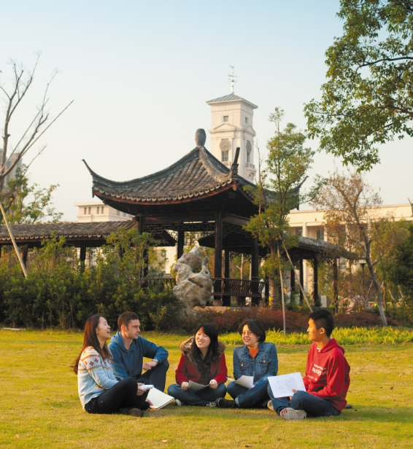

Oral Communication Skills B
(CELEN082)
Live Lecture:
Register and academic presentations

Slide 2
Lesson aims and objectives
Increase your awareness of the register that is typically expected of speakers in academic presentations. Practise speaking using the register that is typically expected of speakers in academic presentations.

Slide 3
Getting started

Slide 4
Getting started
‘Register’ refers to the style of language people use in particular situations. In RWAC, you learnt about the register expected in essays.
Using your experience of academic presentations, decide what register is expected in academic presentations by choosing one of the options on the line.
Informal
The style you use when talking to friends.
Formal
The style you use in essays.
A
B
C
Everyone in your group must agree on the same answer. Persuade each other if you have different opinions. Give at least two reasons.

Slide 5
Presentation register

Slide 6
Presentation register: Rules
Read the pairs of sentences on p.40 of the OCSb Workbook. Decide which sentence in each pair is more common in an academic presentation.
✓
A | 1. Good afternoon. My name is John Burrows.
 | 2. Hiya! I’m John.
✓
B | 1. First, I’ll explain the problem.
 | 2. First, the problem will be explained.
C | 1. OK, so why is obesity such a bad thing?
 | 2. OK, so why is obesity such a serious issue?
✓

Slide 7
Presentation register: Rules
D | 1. Well, there’s significant evidence that similar unhealthy food bans have had an almost immediate impact.
 | 2. Well, there’s loads of evidence that the impact of similar unhealthy food bans has been dead fast.
✓
E | 1. We would need to build a website. Consequently, it would demand time.
 | 2. We’d need to build a website. So it would take time.
✓
✓
F | 1. Similarly, increasing physical activity has been shown to have a significant impact on obesity and would likely be successful in the UK.
 | 2. Similarly, increasing physical activity has been shown to have a significant impact on obesity and would definitely be successful in the UK.

Slide 8
Presentation register: Rules
Based on the example sentences from the previous activity, complete the table below.
In academic presentations, it’s typically appropriate to … | YES | NO
use contractions where possible (e.g. I’ll, there’s).
use very informal or slang words (e.g. Hiya, dead fast).
use vague language (e.g. thing, stuff).
ask rhetorical questions.
use more informal verbs (e.g. take, get, back up, set up).
use personal pronouns (e.g. I, you, we).
use hedging language (e.g. may, likely) when making claims you’re not sure about.
begin ideas with simple conjunctions (e.g. and, so, but).
✓
✓
✓
✓
✓
✓
✓
✓
Identify one feature that is the same as essays. Identify at least three features that are different from essays.

Slide 9
Presentation register: Practice
Cover the OCSb Workbook. Practise saying the sentences below in a more appropriate register.
Hiya! I’m John.
First, the problem will be explained.
OK, so why is obesity such a bad thing?
Well, there’s loads of evidence that the impact of similar unhealthy food bans has been dead fast.
We would need to build a website. Consequently, it would demand time.
Similarly, increasing physical activity has been shown to have a significant impact on obesity and would definitely be successful in the UK.

Slide 10
Presentation register: Reflection
Reflect on the answer that your group gave in the first activity. Decide if you would like to change your answer or keep it the same. Give two reasons why speakers use this register in academic presentations.
Informal
The style you use when talking to friends.
Formal
The style you use in essays.
A
B
C
Everyone in your group must agree on the same answer. Persuade each other if you have different opinions.

Slide 11
Presentation register: Reflection
Informal
The style you use when talking to friends.
Formal
The style you use in essays.
B
The register for academic presentations lies somewhere in the middle.
You are presenting in a formal environment to people who may occupy positions of academic authority.
However, you don’t want to sound too formal as this may create a barrier between you and your audience and make your presentation more difficult to understand.

Slide 12
Practice

Slide 13
Practice
Individually, complete the following tasks:
Record yourself saying five sentences from your OCSb Final Presentation.
Listen to each sentence and check that it follows the ‘rules’ that we discussed today.

Slide 14
Homework
Due | Task
Lesson 10.1 | You will receive the feedback on your PPT by Friday 19th April, 3pm. Review the feedback and make a list of questions you want to ask your OCSb tutor. In Lesson 10.1, you will have the opportunity to ask your questions. Bring your OCSb presentation PPT to class.
Lesson 10.2 | Using the CELE Citation and Referencing Guide, write the references for three of the sources you will use for your Final Presentation. Post them on your class Team.​

